Slide 1
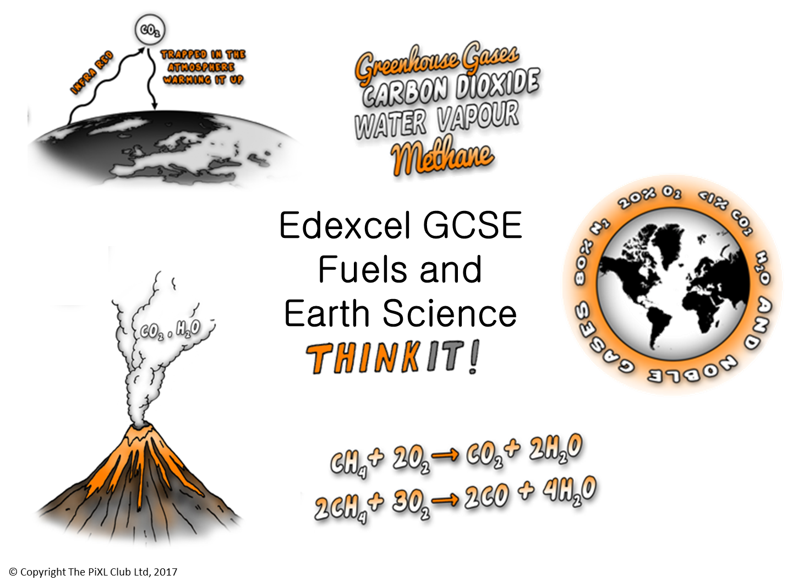

Slide 2
Crude oil, hydrocarbons and alkanes:
Describe how crude oil was formed
Crude oil is a mixture explain the similarities and differences between the chemicals in this mixture.
Crude oil is a finite resource wind power is a renewable resource, explain how crude oil is different to wind power?
The proportion of gases in the atmosphere and the early atmosphere:
The Earth’s atmosphere is dynamic. Explain what this statement means.
Describe and explain the similarities and differences between the Earth’s early atmosphere and the current atmosphere.
How carbon dioxide decreased:
Write the balanced symbol equation to show why the amount of carbon dioxide in the atmosphere has decreased.
Carbon dioxide is naturally captured from the atmosphere through biological, chemical, and physical processes. Explain these processes.
Fractional distillation, properties of hydrocarbons and petrochemicals:
Explain why crude oil separates into fractions during fractional distillation in terms of evaporation and condensation?
Crude oil can be used to make fuels or petrochemicals evaluate the use of crude oil for each of these.
Explain how and why boiling point, visibility and flammability change with changing hydrocarbon size.
How oxygen increased:
Write the balanced symbol equation to show why the amount of oxygen in the atmosphere has increased.
Explain why the amount of oxygen has increased in the atmosphere and the effects this has had on living things.
Discuss why the levels of oxygen in the atmosphere are currently relatively stable.
Edexcel GCSE Fuels and Earth Science
ThinkIT!
© Copyright The PiXL Club Ltd, 2017
Cracking:
Why is cracking useful?
Explain why alkenes are more reactive than alkanes.
Describe the uses of alkenes and explain why they can be used in this way
Modern life would be very different if we did not use hydrocarbons. Use examples to explain this statement.
Pollutants:
Explain with a balanced symbol equation why burning coal may release sulfur dioxide (SO₂).
Explain the implications for humans and other animals of the increases of sulfur dioxide, oxides of nitrogen and particulates in the atmosphere.
Explain some problems associated with acid rain.
Greenhouse gases:
Explain the benefits to Earth of the different greenhouse gases.
Explain why there is a greenhouse effect on Earth.
Increased greenhouse gas levels in the atmosphere can lead to the acidification of the seas and oceans. Explain why this occurs and the implications of this on biodiversity.

